Slide 1
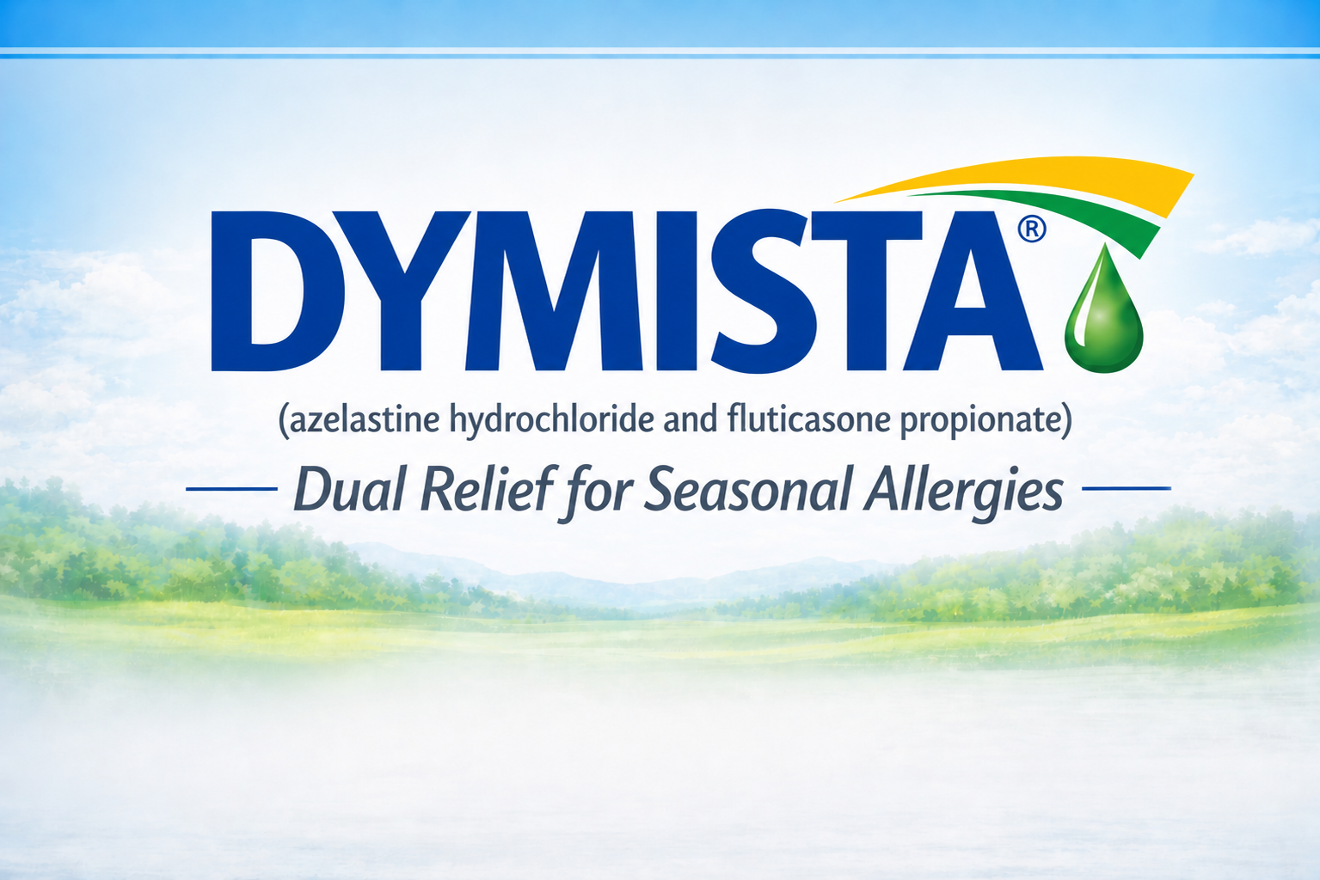
INDICATIONS
DYMISTA is indicated for the relief of symptoms of seasonal allergic rhinitis in adult and pediatric patients 6 years of age and older.
Important Safety Information
DYMISTA is contraindicated in patients with hypersensitivity to azelastine hydrochloride, fluticasone propionate, or to any other ingredients of DYMISTA. Reactions have included anaphylaxis.
Jessica Lewis, PharmD

Slide 2

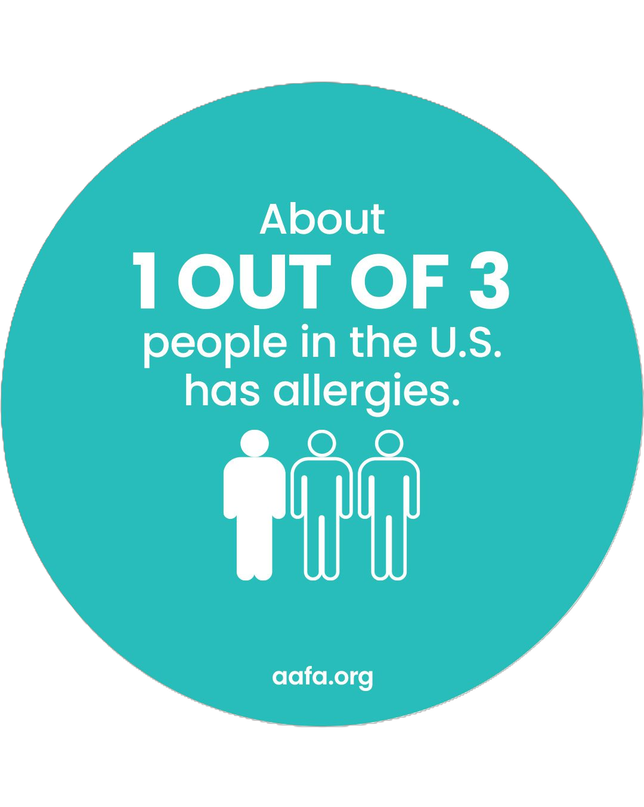
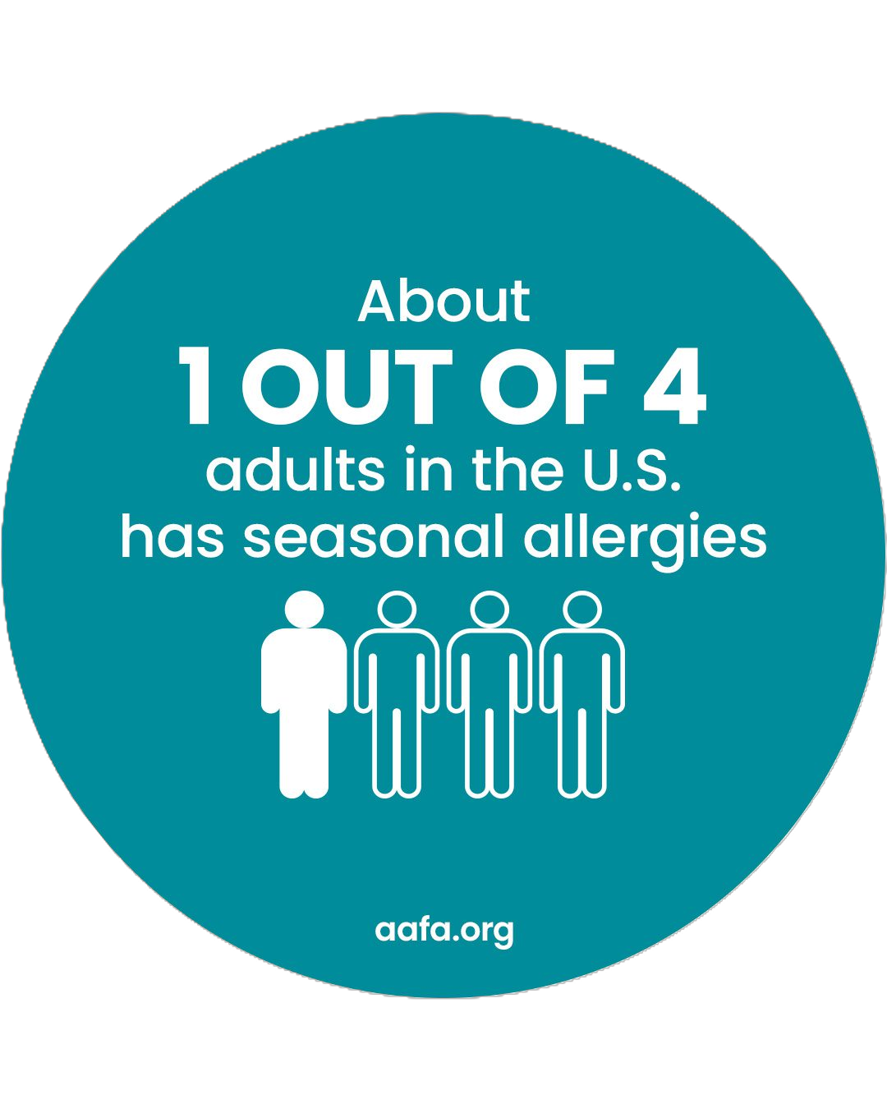
The Burden of Allergic Rhinitis is an Ongoing Clinical Challenge
Allergies are a common chronic disease in the United States; however, the severity of the impact is often overlooked.
  More than 106 million people in the U.S. are affected by allergies (including seasonal allergy, eczema, or food allergy)^{1,2}
Over 82 million people in the U.S. were diagnosed with seasonal allergic rhinitis (seasonal allergies) in 2024.^{1,2}
The symptoms of allergic rhinitis can negatively affect a patient’s quality of life.
The direct medical costs of AR are estimated at $3.4 billion annually in the U.S.³
Why is Allergic Rhinitis a Clinical Challenge?
  The disease severity is underestimated, leading to suboptimal treatment.⁴
  Many patients (74.4%) use multiple therapies to control symptoms of AR, highlighting an unmet need for more effective treatment options.^{5,6,7-9}
AR, allergic rhinitis.
References: 1. Bottoms-McClain L, Giri A, Ng AE. NCHS Data Brief. 2026;(545):10.15620/cdc/174634. 2. Ng AE, Giri A, Bottoms-McClain L. NCHS Data Brief. 2026;(546):10.15620/cdc/174635. 3. Meltzer EO, Bukstein DA. Ann Allergy Asthma Immunol. 2011;106(suppl):S12-6. 4. Maurer M, Zuberbier T. Allergy. 2007;62:1057-63. 5. Canonica GW, Bousquet J, Mullol J, et al. Allergy. 2007;62(suppl 85):17-25. 6. Schatz M. Allergy. 2007; 62(suppl 85):9-16. 7. Dalal AA, Stanford R, Henry H, et al. Ann Allergy Asthma Immunol. 2008;101:23-9. 8. Demoly P, Allaert FA, Lecasble M. et al. Allergy. 2002;57:546-54. 9. Plaut M, Valentine MD. N Engl J Med. 2005; 353:1934-44.

Slide 3
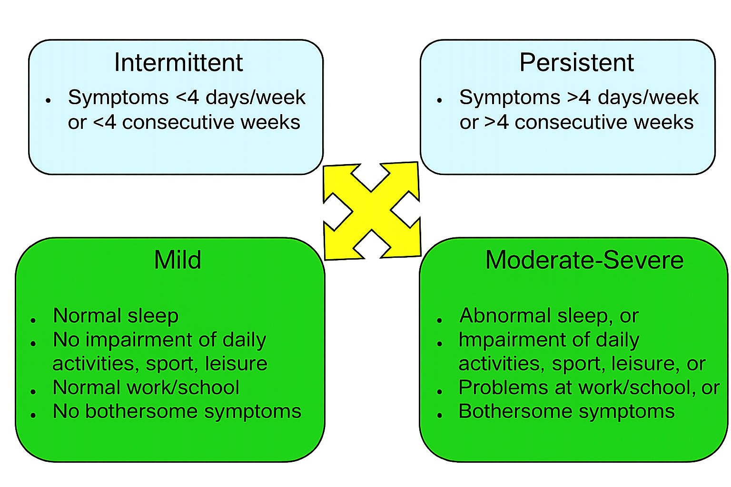
Severity of Allergic Rhinitis and the Impact of Suboptimal Control
Most patients have moderate-to-severe allergic rhinitis and are noncompliant with current therapies, resulting in poor symptom control and impaired quality of life.¹⁻³
Allergic rhinitis symptoms include:⁴
  Sneezing
  Watery eyes
  Rhinorrhea
  Nasal congestion
  Postnasal drip in the throat
The classification of allergic rhinitis by symptoms has influenced the use of patient-reported outcomes; TNSS and RQLQ are crucial for achieving effective management of AR.⁷
Figure 1. Classification of AR according to symptom duration and severity^{5,6}
AR, allergic rhinitis; RQLQ, Rhinitis Quality of Life Questionnaire; TNSS, Total nasal symptom score.
References: 1. Canonica GW, Bousquet J, Mullol J, et al. Allergy. 2007;62(suppl 85):17-25. 2. Schatz M. Allergy. 2007; 62(suppl 85):9-16. 3. Loh CY, Chao SS, Chan YH, Wang DY. Allergy. 2004;59:1168-72. 4. Varshney J, Varshney H. Indian J Otolaryngol Head Neck Surg. 2015 Jun;67(2):143-9. 5. Small P, Frenkiel S, Becker A, Boisvert P, et al. J Otolaryngol. 2007;36(Suppl1):S5–27. 6. Bousquet J, Khaltaev N, Cruz AA, et al. Allergy. 2008;63(Suppl86):8–160. 7. Dykewicz MS, Wallace DV, Bandi S, et al. J Allergy Clin Immunol Pract. 2024;12(10):2574-2582.

Slide 4
ARIA Guidelines Strongly Recommend Intranasal Antihistamine/Corticosteroid Combination Therapy in Allergic Rhinitis when Monotherapy is Inadequate
Intranasal antihistamine/corticosteroid fixed combination therapies are one of the mainstay treatments of AR.¹
In patients receiving monotherapy without clinical improvement, combination therapy with an antihistamine and a corticosteroid is recommended.¹
  Based on the moderate certainty of evidence for SAR
  Applicable to adults and children aged > 4 years old
Table 1. Common Nasal Sprays for the Management of SAR²
Generic Name | Brand Name | Class | Patient Group
Azelastine | ASTELIN® Nasal Spray | Antihistamine | Adults and children over 5 years of age
Azelastine and Fluticasone Propionate | DYMISTA® | Nasal Antihistamine and Corticosteroid | Children and adults 6 years or older
Fluticasone Propionate | FLONASE® Nasal Spray | Corticosteroid | Children (aged >4 years) and adults
ARIA, Allergic Rhinitis and its Impact on Asthma; SAR, seasonal allergic rhinitis.
References: 1. Sousa-Pinto B, Bousquet J, Vieira RJ, et al. Allergy. 2026;81(4):954-976. 2. Nasal Sprays. American Academy of Allery, Asthma and Immunology. Updated March 2026. Accessed May 7, 2026. https://www.aaaai.org/tools-for-the-public/drug-guide/nasal-sprays
Important Safety Information
Somnolence: Avoid engaging in hazardous occupations requiring complete mental alertness, such as driving or operating machinery, when taking DYMISTA.

Slide 5
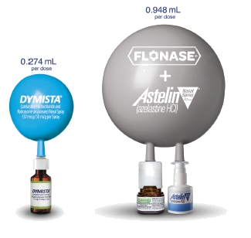
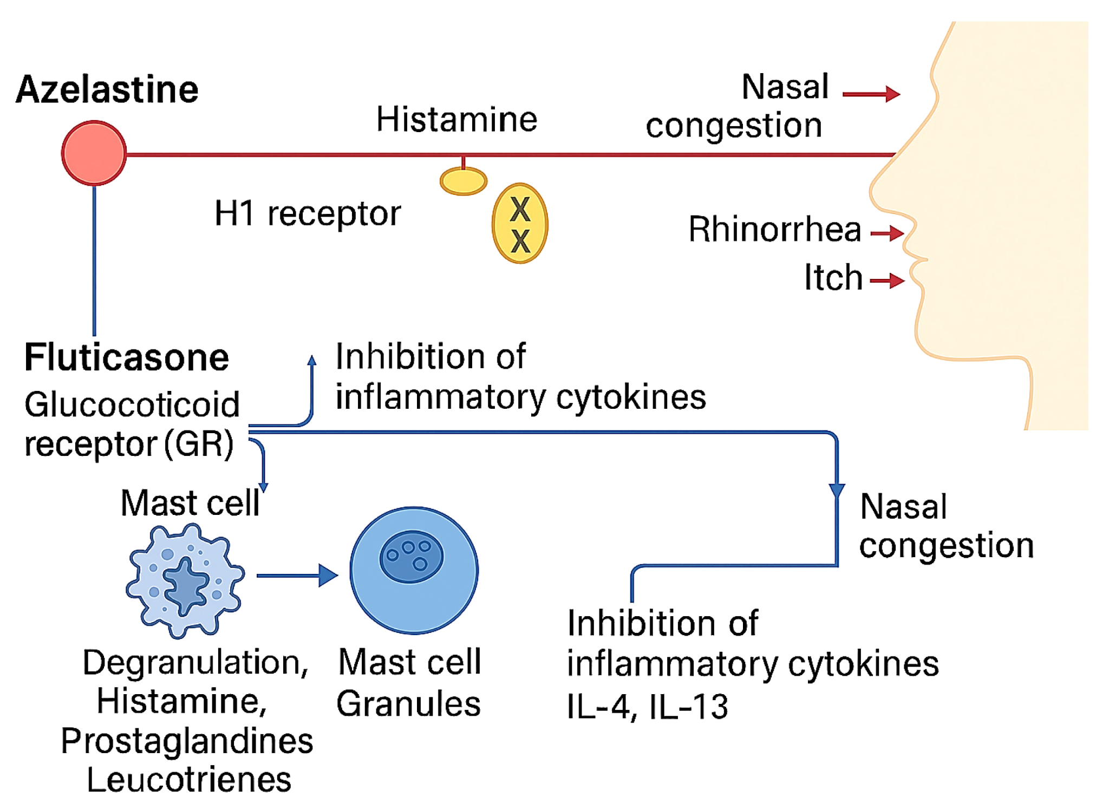
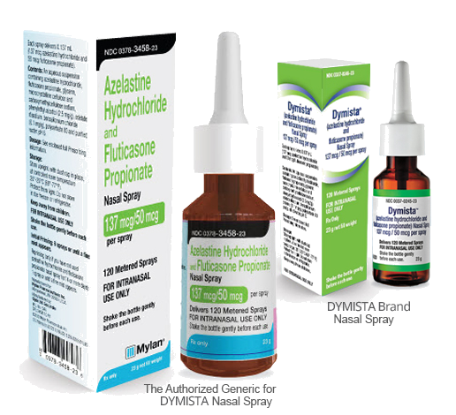
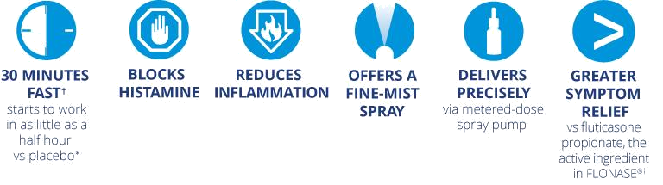
DYMISTA Inhibits the Inflammatory Cascade of Allergic Rhinitis
A.
B.
C.
Figure 1. Mechanisms of action of azelastine and fluticasone in AR.¹
Azelastine blocks H1 receptors, reducing the production of pro-inflammatory cytokines, relieving itching, sneezing, rhinorrhea, and nasal congestion.
Fluticasone binds to intracellular glucocorticoid receptors, thereby decreasing the production of pro-inflammatory cytokines and improving nasal congestion.
Figure 2. DYMISTA breaks down barriers in the treatment of SAR.²⁻⁴
A. The generic of DYMISTA is therapeutically equivalent to DYMISTA Nasal Spray. B. DYMISTA has 71% less spray volume per dose than FLONASE and ASTELIN taken sequentially. C. DYMISTA offers fast and long-lasting relief.
AR, allergic rhinitis; H, histamine; IL, interleukin; SAR, seasonal allergic rhinitis.
References: 1. Indolfi C, Klain A, Dinardo G, et al. Pharmaceuticals (Basel). 2025;18(11):1624. 2. DYMISTA [package insert]. Somerset, NJ: Meda Pharmaceuticals Inc., a Viatris Company; 2021. 3. FLONASE [package insert]. Research Triangle Park, NC: GlaxoSmithKline; 2020. 4. ASTELIN [package insert]. Somerset, NJ: Meda Pharmaceuticals Inc., a Viatris Company; 2019.
Important Safety Information
Avoid concurrent use of alcohol or other central nervous system (CNS) depressants with DYMISTA because further decreased alertness and impairment of CNS performance may occur.

Slide 6
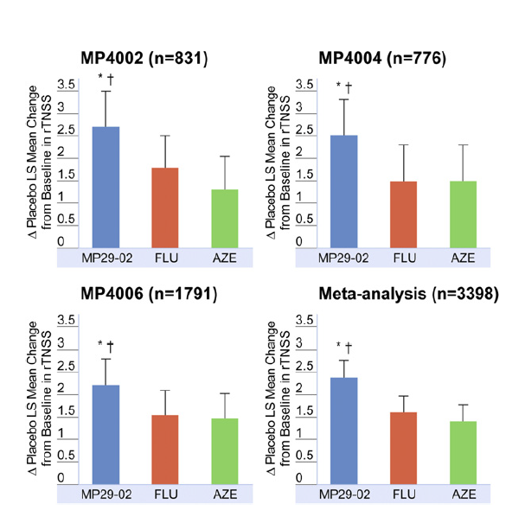
DYMISTA Demonstrated Significantly Greater Improvement in Reflective Total Nasal Symptom Relief¹
3398 patients (>12 years old) with moderate-to-severe SAR enrolled into 3 multicenter, randomized, double-blind, placebo-and active controlled, parallel group trials (MP4002, MP4004, MP4006)
DYMISTA produced a significantly greater reduction in rTNSS compared with the 2 first-line therapies of SAR and placebo
Clinically meaningful improvement confirming the true combination benefit of DYMISTA
Randomization (1:1:1:1)
DYMISTA
(MP29-02)
Fluticasone Nasal Spray*
Azelastine Nasal Spray*
Placebo^{ϯ}
Primary Endpoint:
Change from Baseline in rTNSS
Treatment Period (14 Days)
Twice Daily Intranasal Dosing
Figure 1. Effect of DYMISTA compared to intranasal monotherapies on overall rTNSSs (morning plus evening) in patients with moderate-to-severe SAR.
Secondary Endpoint:
Change from baseline in iTNSS and rTOSS
Study MP4002: *P = .034 versus FP; ^{ϯ}P = .001 versus AZE
Study MP4004: *P = .038 versus FP; ^{ϯ}P = .032 versus AZE
Study MP4006: *P = .029 versus FP; ^{ϯ}P = .016 versus AZE
Meta-analysis: *P <.001 versus FP; ^{ϯ}P < .001 versus AZE
Daily Symptom Assessment
(Reflective Total Nasal Symptom Score)
*The active controls comprised the individual components of MP29-02 in the same vehicle.
^{ϯ}Placebo spray comprised exactly the same vehicle/formulation as the active treatments without any active agent.
AZE, azelastine; FLU, fluticasone propionate; FP, fluticasone propionate; iTNSS, Instantaneous total nasal symptom score; rTNSS, Reflective total nasal symptom score; rTOSS; Reflective total ocular symptom score; SAR, seasonal allergic rhinitis.
Reference: 1. Carr W, Bernstein J, Lieberman P, et al. J Allergy Clin Immunol. 2012;129(5):1282-1289.e10.
Important Safety Information
Epistaxis, nasal ulcerations, nasal septal perforation, impaired wound healing, Candida albicans infection: Monitor patients periodically for signs of adverse effects on the nasal mucosa. Avoid use in patients with recent nasal ulcers, nasal surgery, or nasal trauma.

Slide 7
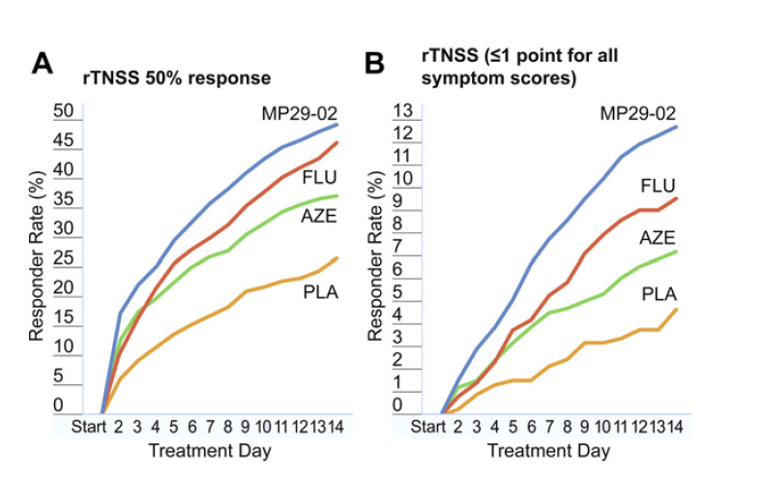
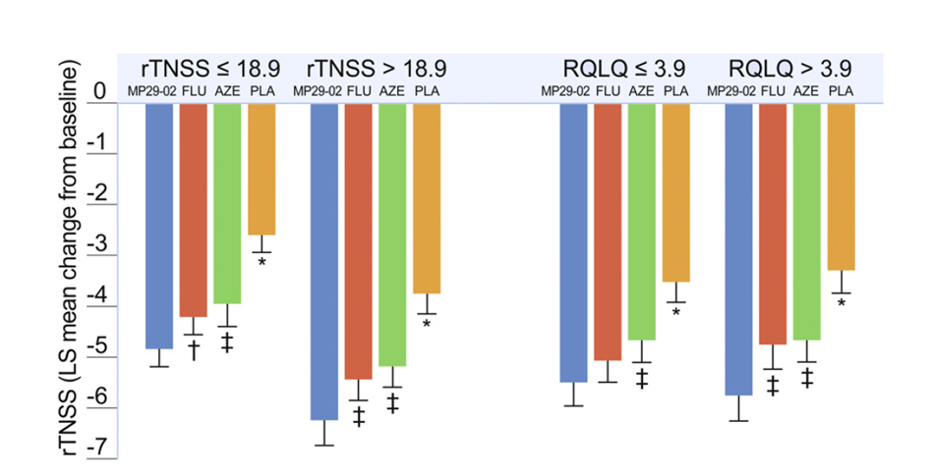
DYMISTA Responded Faster and Delivered Greater Symptom Relief Regardless of Disease Severity¹
Figure 1. Time-response curves showing the % of patients exhibiting 50% improvement in rTNSSs:
(A) or a score <1 point (ie, complete or near-complete resolution) for each nasal symptom
(B) by treatment day after treatment with DYMISTA(n = 834), FLU (n = 846), AZE (n = 847),
or PLA (n = 857).
Figure 2. Effect of DYMISTA, intranasal monotherapies and placebo on rTNSS
by severity in patients with SAR
(baseline rTNSS score <18.9 [DYMISTA: n = 425; FP: n = 407; AZE: n = 417; PLA: n = 407] or >18.9 [DYMISTA:
n = 423; FP: n = 438; AZE: n = 427; PLA: n = 449] or baseline RQLQ score <3.9 [DYMISTA: n =374; FP: n = 382; AZE: n = 382; PLA: n = 364] or >3.9 [DYMISTA n = 363; FP: n = 356; AZE: n = 365; PLA: n = 373]).
DYMISTA versus FLU: P = .071; DYMISTA versus AZE: P < .001; DYMISTA versus PLA: P < .001
DYMISTA versus FLU: P = .033; DYMISTA versus AZE: P < .001; DYMISTA versus PLA: P < .001
*P < .001 versus all active treatments. ^{ϯ}P < .040 versus DYMISTA.‡P < .010 versus DYMISTA.
DYMISTA demonstrated rapid symptom improvement, earlier than typically seen with intranasal corticosteroids alone.
DYMISTA was superior to the monotherapies in relieving nasal symptoms associated with SAR, regardless of disease severity.
AZE, azelastine; FLU, fluticasone propionate; PLA, placebo; RQLQ, Rhinitis Quality of Life Questionnaire; rTNSS. Reflective total nasal symptom score; SAR, seasonal allergic rhinitis.
Reference: 1. Carr W, Bernstein J, Lieberman P, et al. J Allergy Clin Immunol. 2012;129(5):1282-1289.e10.
Important Safety Information
Glaucoma or posterior subcapsular cataracts: Monitor patients closely with a change in vision or with a history of increased intraocular pressure, glaucoma, and/or cataracts.

Slide 8
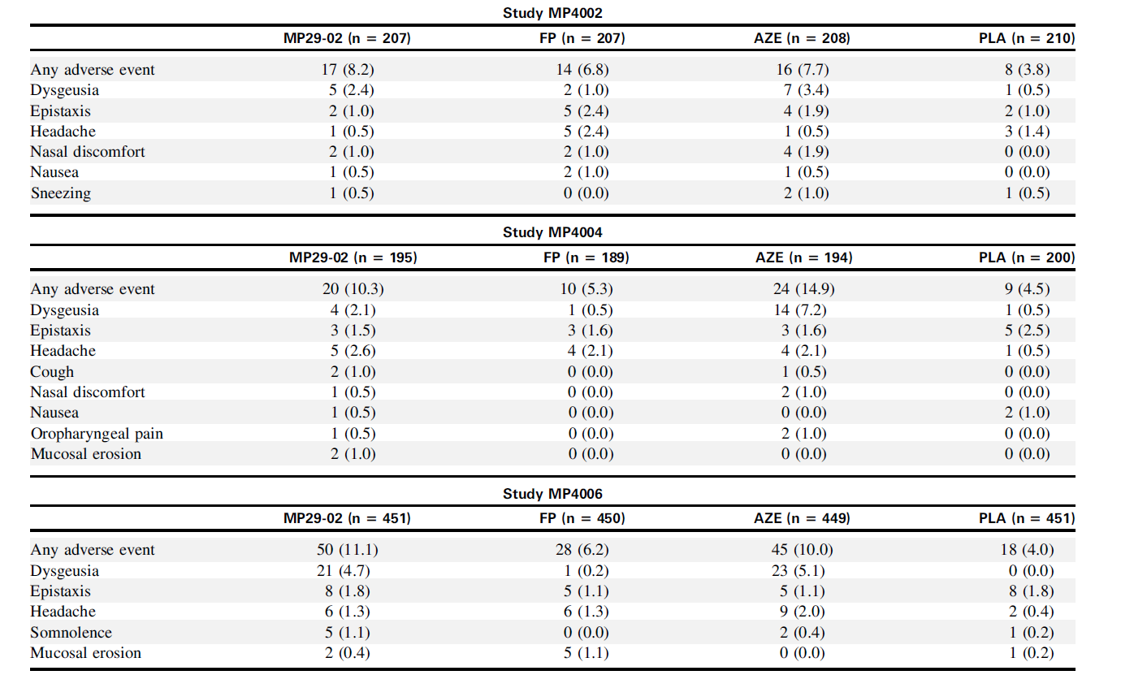
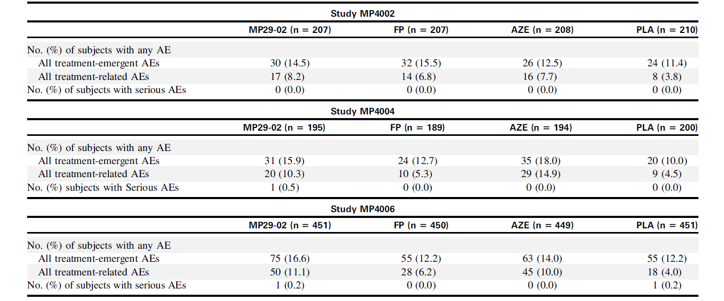
Similar Safety Profiles Across Treatment Groups in SAR¹
Table 2: Overview of treatment-related, treatment-emergent adverse events
Table 1: Overview of adverse events
AE, adverse event; AZE, azelastine; FLU, fluticasone propionate; PLA, placebo.
Reference: 1. Carr W, Bernstein J, Lieberman P, et al. J Allergy Clin Immunol. 2012;129(5):1282-1289.e10.

Slide 9
Improved Outcomes With DYMISTA Compared With Monotherapy Intranasal Sprays
Superior Symptom Control vs Monotherapy
  Consistently showed significantly greater reduction in reflective total nasal symptom score (rTNSS) vs intranasal steroids or antihistamines alone.¹
  Statistically significant relief of ocular symptoms was achieved with combination therapy compared with intranasal fluticasone propionate.¹
Real-World Impact
More patients achieve meaningful symptom control, especially in moderate-to-severe SAR.
Improved Adherence via Single Device
Simplifies treatment → better adherence and persistence
Particularly valuable in polypharmacy
  Combines two therapies into one spray
  Eliminates need for:
    Multiple prescriptions
    Complex dosing regimens
Reference: 1. Carr W, Bernstein J, Lieberman P, et al. J Allergy Clin Immunol. 2012;129(5):1282-1289.e10.
Important Safety Information
Potential worsening of existing tuberculosis, fungal, bacterial, viral, or parasitic infections, or ocular herpes simplex. More serious or even fatal course of chickenpox or measles in susceptible patients. Use caution in patients with the above because of the potential for worsening of these infections.

Slide 10
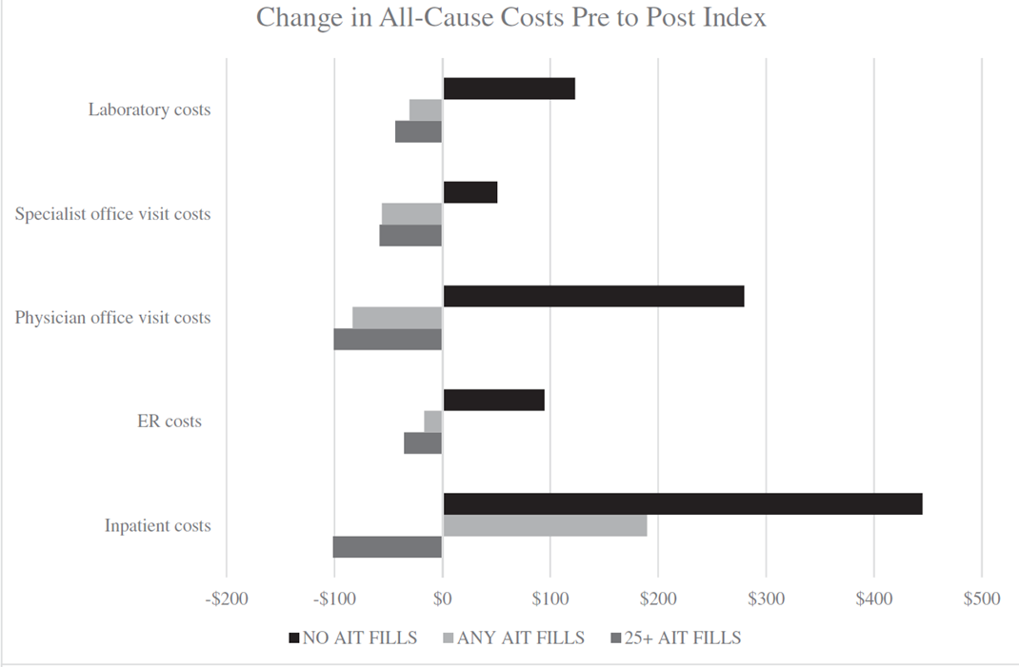
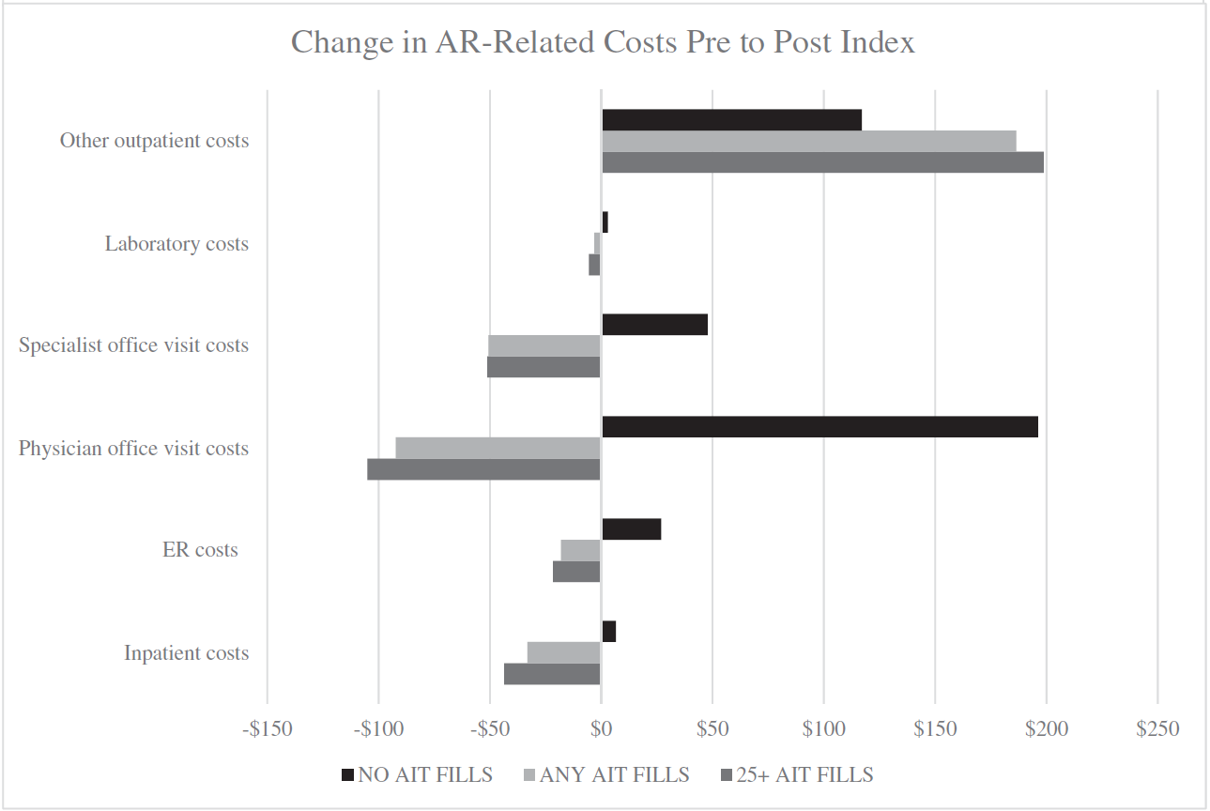
Real-World Evidence Demonstrates the Economic Impact of Allergy Immunotherapy in Allergic Rhinitis¹
Figure 1. All-cause and AR-related cost differences baseline to follow-up by AIT cohorts.
Allergen immunotherapy may:
  Reduce overall healthcare utilization
  Lower AR-related medical visits
  Decrease inpatient and ER costs
  Improve disease control over time
Higher adherence to AIT (25+ fills) associated with:
  Better cost outcomes
  Lower acute care utilization
  More stable healthcare spending
AIT, allergy immunotherapy; AR, allergic rhinitis; ER, emergency room
Reference: 1. Tkacz JP, Rance K, Waddell D, et al. Curr Med Res Opin. 2021;37(6):957-965.
Important Safety Information
Hypercorticism and adrenal suppression with very high dosages or at the regular dosage in susceptible individuals. If such changes occur, discontinue DYMISTA slowly.

Slide 11
DYMISTA Delivered Superior Efficacy with Rapid Relief in a Simplified Single-Spray Formulation¹⁻³
DYMISTA demonstrated superior efficacy compared with intranasal fluticasone and azelastine monotherapy across three randomized, double-blind, placebo-controlled studies using the same device and formulation.
Findings provided strong evidence that combining an intranasal antihistamine with a corticosteroid offers complementary benefits in SAR and aligns with ARIA guideline recommendations.
Similar safety profiles were observed across treatment groups, with only mild dysgeusia reported in a small number of patients in the DYMISTA and azelastine treatment groups.
Allergy immunotherapy remained a cost-effective treatment option without increasing overall healthcare expenditures.
DYMISTA provided a rapid onset of action, achieving a clinically meaningful 50% reduction in rTNSS earlier than standard therapies, with symptom improvement occurring up to 3 days sooner than fluticasone and up to 5 days sooner than azelastine.
  This faster relief is clinically important because earlier symptom control can improve patient adherence.
DYMISTA delivered superior efficacy, rapid onset, and simplified treatment, directly addressing the unmet need among patients with uncontrolled allergic rhinitis.
ARIA, Allergic Rhinitis and its Impact on Asthma; rTNSS, Reflective total nasal symptom score; SAR, seasonal allergic rhinitis.
References: 1. Carr W, Bernstein J, Lieberman P, et al. J Allergy Clin Immunol. 2012;129(5):1282-1289.e10. 2. Tkacz JP, Rance K, Waddell D, et al. Curr Med Res Opin. 2021;37(6):957-965. 3. Marple BF, Fornadley JA, Patel AA. et al.Otolaryngol Head Neck Surg. 2007;136(suppl):S107-24.
Important Safety Information
Potential reduction in growth velocity in children. Monitor growth routinely in pediatric patients receiving DYMISTA.

Slide 12
IMPORTANT SAFETY INFORMATION
DYMISTA is contraindicated in patients with hypersensitivity to azelastine hydrochloride, fluticasone propionate, or to any other ingredients of DYMISTA. Reactions have included anaphylaxis.
Somnolence: Avoid engaging in hazardous occupations requiring complete mental alertness, such as driving or operating machinery, when taking DYMISTA.
Avoid concurrent use of alcohol or other central nervous system (CNS) depressants with DYMISTA because further decreased alertness and impairment of CNS performance may occur.
Epistaxis, nasal ulcerations, nasal septal perforation, impaired wound healing, Candida albicans infection: Monitor patients periodically for signs of adverse effects on the nasal mucosa. Avoid use in patients with recent nasal ulcers, nasal surgery, or nasal trauma.
Glaucoma or posterior subcapsular cataracts: Monitor patients closely with a change in vision or with a history of increased intraocular pressure, glaucoma, and/or cataracts.
Potential worsening of existing tuberculosis, fungal, bacterial, viral, or parasitic infections, or ocular herpes simplex. More serious or even fatal course of chickenpox or measles in susceptible patients. Use caution in patients with the above because of the potential for worsening of these infections.
Hypercorticism and adrenal suppression with very high dosages or at the regular dosage in susceptible individuals. If such changes occur, discontinue DYMISTA slowly.
Potential reduction in growth velocity in children. Monitor growth routinely in pediatric patients receiving DYMISTA.
Potent inhibitors of cytochrome P450 (CYP) 3A4: May increase blood levels of fluticasone propionate.
Ritonavir: Coadministration is not recommended.
Other potent CYP3A4 inhibitors, such as ketoconazole: Use caution with coadministration.
The most common adverse reactions (≥2% incidence) are dysgeusia, epistaxis, and headache.

